Slide 1

Get Comfortable with the New Microsoft Azure PowerShell Az Commands
Tim warner
Timw.info

Slide 2
Learning goals
Describe the past, present, and future of Azure PowerShell
Build your Azure PowerShell development environment
Get competent with Az PS and (gasp) CLI?!

Slide 3
Session materials
timw.info/psotr

Slide 4



Let's get to the demo!
Invoke-Learning –Method 'Practical Application'

Slide 5
Refactoring your Existing scripts
PSScriptAnalyzer (!?)
Thanks to @jaykul!

Slide 6
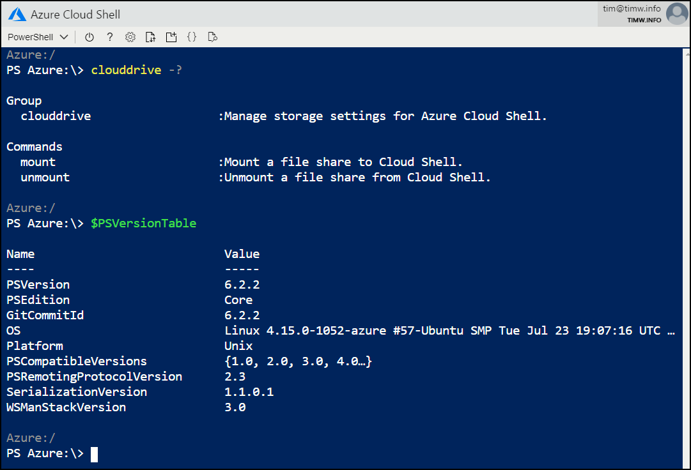
Azure powershell in azure cloud shell

Slide 7
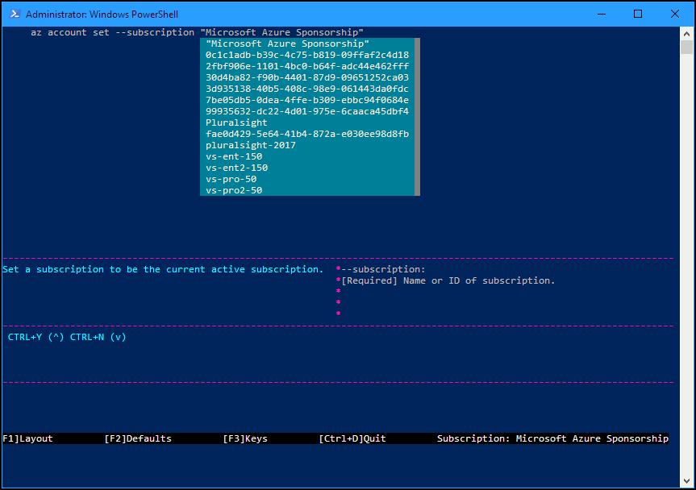
Azure command-line interface (CLI)

Slide 8
Thank you!
Session materials: timw.info/psotr
Personal website: timw.info
Pluralsight courses: timw.info/ps

